Slide 1
Introductory Java and FTC Programming Workshop
Week 1 - Loops and Functions (Oct. 24)
Hanson Chan
Notes:
Hello Everyone! Welcome to my workshop for Introductory Java and FTC Programming. Before I begin, I would like to thank you all for coming, and Esquimalt High School for hosting.

Slide 2
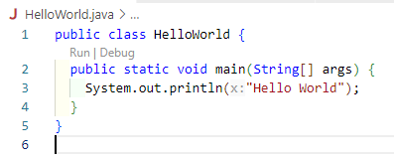
Recap of last week

Slide 3
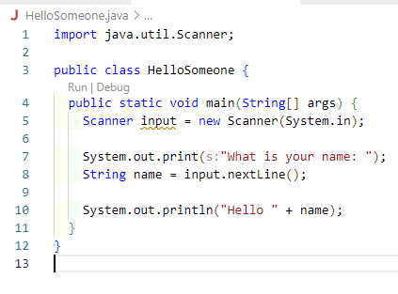
Recap of last week

Slide 4
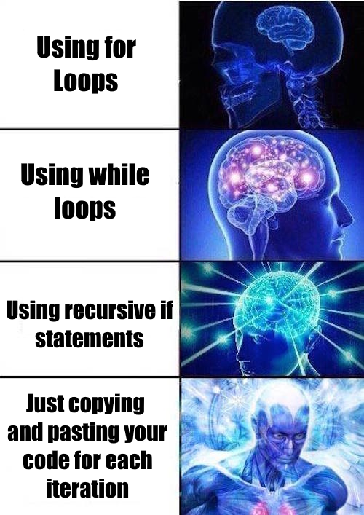
Java Loops
Definite loops
For loops
Indefinite loops
While Loops
Do While loops

Slide 5
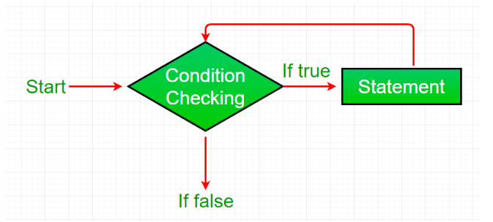
Which loop is this?
Notes:
While Loop

Slide 6
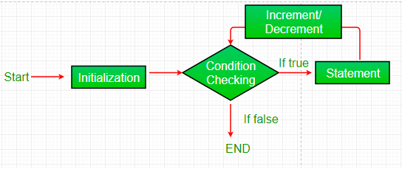
Which loop is this?
Notes:
For loop

Slide 7
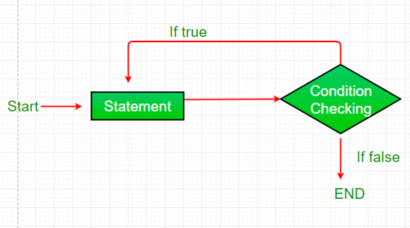
Which loop is this?
Notes:
Do While Loop

Slide 8

Programming Challenge
Mario!
https://cs50.harvard.edu/x/2024/psets/1/mario/less/
Have a prompt that asks for an integer
Ensure input is between 1-8
Print the Pyramid
Bonus:
Mario+
https://cs50.harvard.edu/x/2024/psets/1/mario/more/

Slide 9
Programming Challenge (Cont.)
How to solve? Start with Pseudocode
If unsure how to solve the problem itself, break it down into smaller problems that you can probably solve first. For instance, this problem is really two problems:
Prompt the user for the pyramid’s height
Print a pyramid of that height

